Slide 1
TTMS Simplification

Slide 2
Agenda
Engagement Objective and Scope | 3
Our Understanding | 4
Execution Approach | 5
Assumptions | 7
Proposed Technical Solution – REST EASY | 8
Alternate Technical Solution – Apache CXF | 10
Solution Comparison | 12
Recommendations | 14
Team Structure | 15
Risks and Mitigation Plan | 16
Commercials | 17

Slide 3
Engagement Objectives and Scope
Objective
Design & develop a integration module to ensure seamless data communication between the Freight Planning and Auditing system (ICL) and the TTMS mainframe system
Ensure minimal / no impact to the Down stream applications.
In Scope
Design the To-be architecture for the integration module using web services
Develop one outbound interface from TTMS to ICL and 12 inbound interface from ICL to TTMS
Web service security using TESS and EIG
Conduct functional testing and parallel validation for the 12 Inbound and 1 outbound interface
Develop a tool for conduction parallel validation between existing TTMS system and the new integration module (sub- prod)
Conduct end to end parallel validation between existing TTMS system and the new integration module to validate overall functionality (sub- prod)
Conduct performance testing for the new integration module (12 inbound and one outbound interface)
Cutover from existing OTM to new Freight Planning and Auditing system (ICL) system
Support UAT
Out
Of Scope
Data flow between ICL and Carriers
Decommissioning of existing systems
Message sequencing
Report Generation
Data Quality validation for all Inbound Interface from ICL system
Creation of User Manuals

Slide 4
Our Understanding
TMS
TTMS
NAP CPU PROCON
DEALER ALLOCATION /
DEALER CHANGE
DEALER INFO
VEHICLE INFO
EVENTS
ICL
NVS
Create Order / Shipments
Mainframe Tables
Bulk Planning
NPPS
Shipments Events DB
Deviation Request
VDW Staging
Invoice
Shipping schedule
VDW
Online Logistics Report
Transit
Accrual
FTPR
Voucher
Carriers
Vessel ETA
Queues
PeopleSoft
Not In Scope

Slide 5
Execution Approach
Aug 15 – Nov -15
Dec 15 – Aug 16
Sep 16 – Feb 17
Mar 17 – May 17
Elaboration
End to End Testing
Transition
Construction
Integration Use Cases
TMS - System Architecture
ICL Architecture
Technical Design
Dev. Infra. Readiness
Test Strategy & Design
Parallel validation tool
Vessel ETA
Outbound from TTMS to ICL
Transit
Shipment Plan
Shipment Actual
Interim Performance Validation and Pre- UAT
Payment Vouchers
Development
Shipping Schedule
Functional Testing
VDW
Integration Testing
Parallel Validation
Performance Testing
End to End Testing
UAT Support
Go Live
* The above iterations are only representation of our execution methodology and doesn’t depict the actual effort / time line for each iteration

Slide 6
Incremental Development
Changes Request (Change Management )
Incremental Development
New Requirements
Feedback
Functional Design
Development
Functional
Testing
Feedback
Integration Testing
Parallel
Validation
End to End Parallel
Validation
Performance Testing
UAT
Go Live
Feedback
Integration Design
Development
Functional
Testing
Feedback
New Requirements
Changes Request
(Change Management )
ICL
Each interface will be developed and tested using the Incremental development process
Cognizant

Slide 7
Assumptions
Existing TTMS mainframe tables and their attributes will not undergo any changes or transformation
List of attributes defined in the BRD for the 12 inbound files from ICL to TTMS and the 1 outbound file from TTMS to ICL will not be changed / modified
A new staging table ( will all 8 tables listed in the BRD )will be created for VDW in the TTMS mainframe system
ICL will align to the incremental development model to support the Integration testing & Parallel Validation
The Parallel validation tool will compare the Data between the current and the To-Be system and will report any delta / data discrepancies between the two systems
All downstream systems (VDW, FTPR etc.) will be available for the final end to end parallel validation
Errors in the parallel validation will be dealt by ICL
Framework selected is aligned with the existing Toyota's architecture guidelines
TTMS REST services will rely on integrated TESS authentication & authorization mechanism
SSL over HTTP will be utilized between ICL-TTMS communication vice versa
Cross domain security integration will be established between ICL-TESS to utilize SAML and TESS Integration is out of scope.
Data transformation will be done using Data power
Existing queues will be decommissioned to adopt complete full-fledged usage of the proposed TTMS
Adequate failover queue configuration will be made available as part of the TTMS infrastructure
Two separate testing environments will be made available for parallel validation.
Effort includes the performance testing of 14 Web services involved in In-bound & Out-bound transactions with ICL, in isolation only.
ProCons, NAP Day, Bulk upload scenarios are considered out of scope
Performance testing effort includes the effort for Load, Stress and Endurance runs
Performance Testing environment is production-like in capacity & size and will have necessary firewall/port access for accessing the application from Test agent machines for creating data, testing & monitoring.

Slide 8
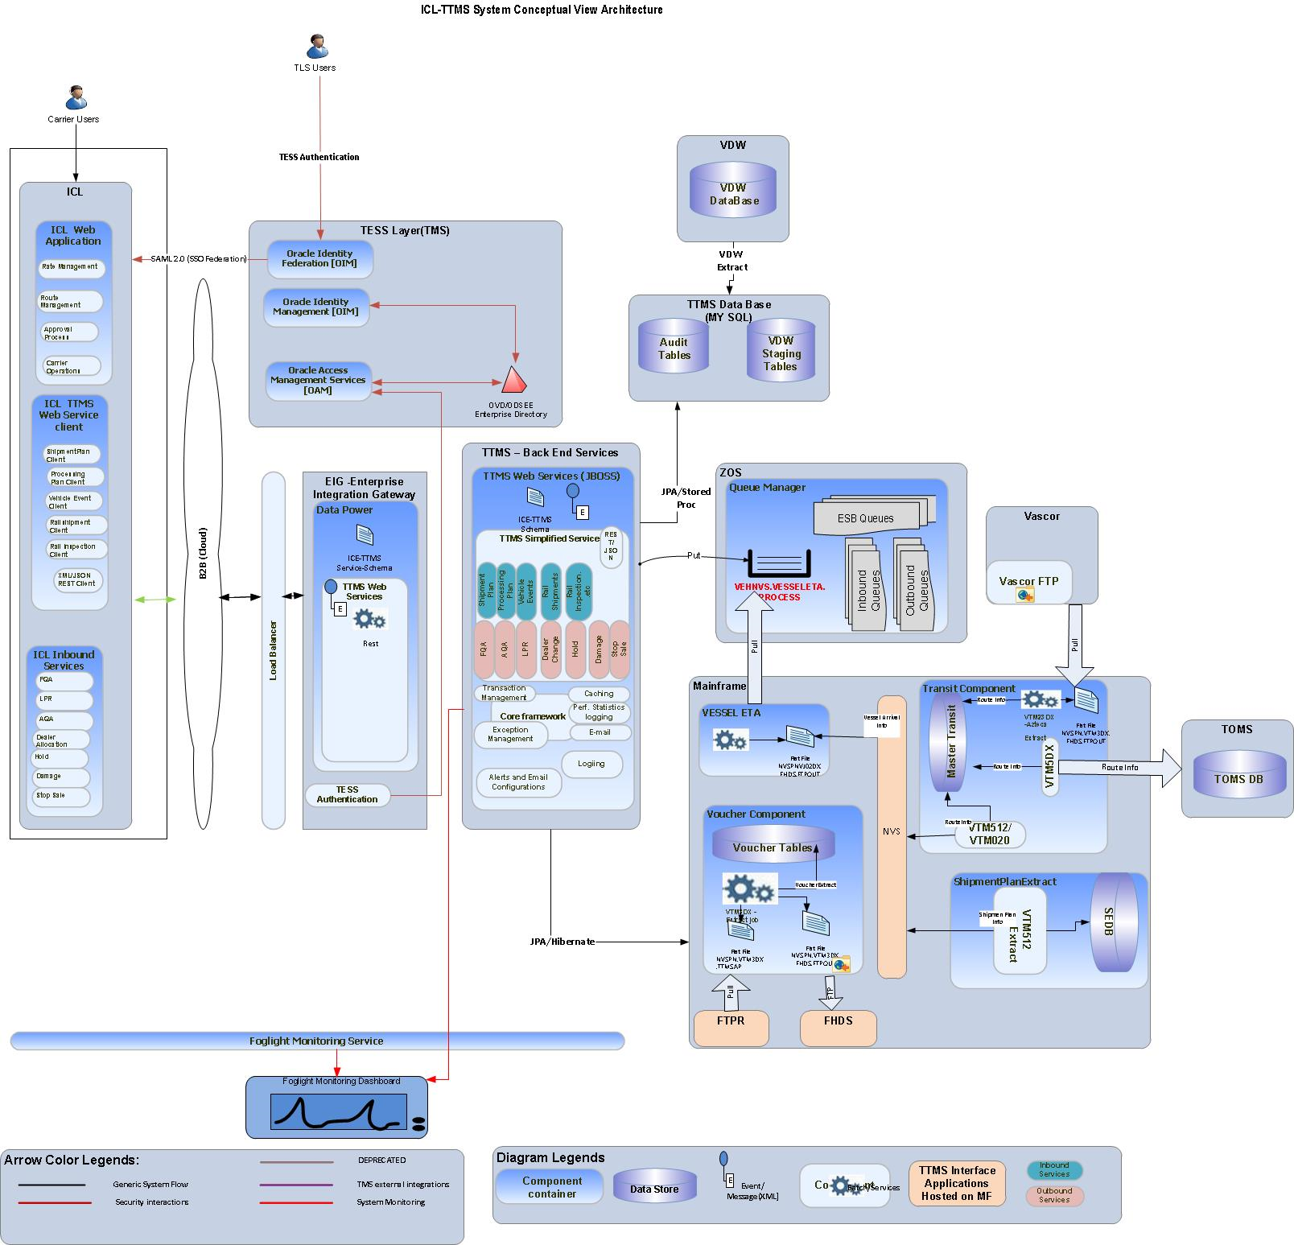

Slide 9
Proposed Solution – Solution Highlights
Proven, Simple to implement framework – REST Easy with JSON implementation
Spring Framework with TMS Application framework will act as the foundation framework.
Transport acknowledgement with loosely coupled service will be designed.
Implementation of new scalable technology stack recommended by TMS domain group.
Jboss provided MQ or Spring JMS will be implemented with multiple queues for each message category
Redwood Scheduler/Spring Batch will be used to define the batch process.
EIG Data Power will be reused with existing ESB Queues to process to send the events to ICL through TTMS Integration.
Service definition for web services exposed by TTMS will be fused through EIG Data Power
Service definition for web services exposed by ICL will be consumed through EIG Data Power
Business Failure transactions will be re-processed with recycling and error recovery process.

Slide 10
<< SAML Over HTTP >>
<< REST WS over SSL >>
EIG
TESS
NVS
Data Power
TTMS Message Bridge
TTMS Web Service
SFTP Gateway
OIM Federation
NPPS
OIM Identity Management
jBoss Application Server
DB2 Load
Redwood
OAM Access Management
Selva to revisit / update the architecture diagram
SEDB – DB2
Shipment Plan
Processing Plan
Rail Shipments
Accrual
Rail Inspections
Vehicle Summary
Vehicle Events
Payment Voucher
Shipping Schedule
ICL
EJB MDB
SFTP
HornetQ
CXF
Jackson
NEON
Queue Manager
Spring
REST Client Services
Transit
Vessel ETA
VDW
Transit – DB2
VDW
Staging – DB2

Slide 11
Alternative Solution – Solution Highlights
Spring Framework will act as the foundation framework for integrating various external entities
Apache CXF with Jackson will serve the purpose of fulfilling REST service requirements
Single Consolidated HornetQ will be implemented with multiple queues for each message category
HornetQ will address scalability requirements by implementing Clustered Queues
Asynchronous MDB Listeners will be configured to be activated to process business logic
Redwood Scheduler will be used to launch file load process
Data Power will be enabling ICL to transfer files through SFP to TTMS servers
DB2 Load will be utilized to transform and load huge volume of batch data to appropriate tables
EIG Data Power will be configured with Message Queues to process inbound feeds from NVS & NPPS
Service definition for web services exposed by TTMS will be fused through EIG Data Power
Neon Drivers will be utilized for store & retrieve the details from Transit, SEDB & VDW database. Neon is a thin driver proprietary to IBM which facilitates connectivity to DB2 tables
Vessel ETA WS call configured in the ICE layer will post message to the TTMS queue for processing
All incoming Web service requests from ICL will be logged first in the database
Redwood will pickup the records and do the processing and failure notifications will be sent passively
Selva to revisit / update the architecture diagram

Slide 12
Solution Comparison
Critical / Focused Features | Pros | Cons
ICL – TMS Web Services Integration
REST EASY & Jackson, Spring | Proven & Leading framework Spring eases integration with MQ & JAX-RS Easy to implement Web Services with Jersey Automatic JSON conversion with Jackson Featured array conversion with Moxy Easier TESS integration through Spring | Handling attachments through REST will not be as effective as SOAP-MTOM
CXF REST, Jackson, Spring | Effective Pre & Post Processing (CXF) Pluggable Security Layers to Web Services (CXF) | Time to market is little higher considering the configuration requirements.
Message Sequencing & Ensuring High Availability
HornetQ with Multiple End points | Provide failover capability hence ensures high availability ( Messages will be replicated across fail over queues ) Hence independent messages are processed separately it will ensure high performance Message usage will be distributed hence will avoid memory leaks at peak load scenarios. Configuration is easier hence HornetQ is the jBOSS native implementation No Sequencing will be required hence there wont be any downtime. | May see additional permission requirements to install required software in cluster nodes. Implementation is little difficult comparing other scenarios
Single Consolidated Queue with HornetQ | Reliable, as no message will be processed in uneven order hence sequence will be maintained Message sequencing will be taken care automatically hence message posting will be in sequence | Processing will be delayed a bit hence the queue length will be more hence everything is pumped in one queue

Slide 13
Solution Comparison… Cont’d
Critical / Focused Features | Pros | Cons
Batch Processing Incoming Feeds
Receive files as attachment, store to disk. Redwood scheduler will launch the process to load the data. DB2Load package will parse & load data to DB | Will meet high volume processing, performance expectations Reliable and will be faster due to native DB processing No need to create separate Inserts/Update Statements Manually Avoids creating dynamic SQLs through java which will save us from strange scenarios Won’t create Blocking IO | May not have fine control of success & failure of transactions during inserts & Updates
Transmit files directly from ICL to TMS through SFTP and notify TTMS upon successful transmission using JAX-RS | FTP will be much faster comparing all above approach in transferring files DB2Load will be much faster in transforming data & executing against the DB Will completely avoid complex java processing of object constructions, Execution Etc. | Fine Grained access, security privileges must be established for executing shell scripts.
Web Service Message Sequence & Error Handling
Supplementary tables with real-time WS Notification. Neon for Accessing DB | Flow restricts to store suspected error prone calls alone to supplementary tables Hence processing successful records instantly it will reduce backlogs | Unexpected system failures could add more number of transactions to the overall pending list.
Store & Proceed with Error Queue - Passive Error Notification. HarnetQ for error queue implementation & MDB for listeners | Streamlined flow for handing success, failure cases separately | Will add database overhead hence it adds all successful / failure cases to the database Additional querying mechanism & process to fetch and process the data

Slide 14
Recommendations
We strongly recommend the REST EASY solution as the best fit for the TMS-ICL Integration requirements.
Some of key Solution Highlights for the recommendation are as below.
Rich interceptor model
OAUTH2 and distributed SSO support with AS7
Provide failover capability hence ensures high availability and independent messages are processed separately ensuring high performance
In build facility to bring exception messages.
Will meet high volume processing, performance expectations
Reliable and will be faster due to native DB processing
Less time to market & learning curve

Slide 15


Team Structure
TMS/USA
Cognizant Onsite
Cognizant Offshore
National Technology Manager
Program Manager
Delivery Manager
AUTO Vertical Manager
AUTO Vertical Manager
Technology Manager
Development Lead
PT Lead
CBC Consultant
QA Consultant
CBC Consultant
QA Lead
SMEs
Development Lead
COE Experts

Slide 16
Risks and Mitigation Plan
Risks | Impact | Mitigation Plan
Non availability/ inordinate delays in access to TTMS SMEs for discussions/query resolution/reviews during project timelines | Impact on project cost, and schedule | At end of Due Diligence, Cognizant will publish an revised SME calendar agreed with all concerned parties to ensure a planned approach. TTMS to ensure that SMEs are available in line with the published timetable.
ICL not being ready enough to provide quality data | Might delay/increase the testing effort
Changes in scope | Impact on project cost, and schedule | Changes in scope of this project will follow established change management process upon mutual consensus between TMS and Cognizant.
Sign-off/Clarification turnaround | Schedule & Cost | in receiving response for delivered artifacts or clarification may impact the project schedule and cost. In such cases the impact is handled through change management process..
To be Updated

Slide 17
Commercial
Pricing
Duration
Staff load
Assumptions
Arumugam – to update

Slide 18
Thank You

Slide 19
As-Is System
Inbound
ICE
Outbound
WAS
NVS
OTM
ESB Queues
Inbound Queues
HTTP Post
NPPS
Outbound Queues
Business Data Model
Hyperion Reports
B2B / Carriers (Mainframe)
Shipments Events DB
Mainframe System
VEHNVS.VESSELETA .PROCESS
Down Stream Applications

Slide 20
Execution Approach and Deliverables
TO BE Use Case Creation
POC for Technical Solutions
Test Strategy
SAD
IDD
ASD
ADD
<<check with Testing Team>>
Develop Code
Perform UT
Junit, Veracode
CAST Adoption
Toyota Build Farm for continuous integration and deployment
Parallel Testing
Functional Testing
Automation
TTMS Regression
UAT Instruction
Test Scripting
Test Execution
Analysis of Performance statistics
Report presentation
UAT Support
Defect Triaging and fixing
Deployment Plan
Deployment documentation
Perform deployment in production
Sanity Testing
Post Production Support
Incident resolution
Defect triaging and fix
Elaboration
Design & Development
System Testing
Performance Testing
User Acceptance/ Parallel Validation
Go-Live
Warranty Support
Deliverables
AS IS and TOBE Use Case, NFR, SAD, IDD, ASD, ADD
Unit Tested Code, Test Logs
System Test Log, System tested code, Defect fixes, UAT Instruction
Performance Test scripts, Performance Test Reports
UAT Support, Defect fixes
Deployment Document, Production deployment
Post Production Support

Slide 21


QA Approach
Test Planning & Strategizing
Test Designing/Test Development
Test Execution
Production Deployment
Requirement gathering from Business
Test scenario creation for the type of testing as applicable for AUT
Build Deploy
(Unit Tested)
UAT Scenarios
Critical Test Scenarios
Requirement walkthrough to QA & PT team
Outbound XML
Inbound XML
SEDB Tables
VDW staging
Functional Testing
Test scenario review
Requirement clarification to QA t PT team
Test case creation for the type of testing as applicable for AUT
ICL
VDW
PeopleSoft
NVS
NPPS
Integration/End to End Testing
Test requirement scoping and Analysis
Test case review
Review requirements and estimate testing effort
Performance Script Development
Parallel Tool Testing
Pre-Production Validation
User Acceptance Testing
Production Deployment
Formulate Functional Test Plan and Performance Test Plan
Script Review
Test Data Set up
Parallel Testing
Walkthrough of Test plan with key project stakeholders
Devise master level and release specific test strategy
Inbound and Outbound Webservices Testing
Load, Endurance &Stress Testing
Iterative Performance Testing
Sign off on test plan / strategy
Defect Management – Defect Reporting, Triage, Defect Fix Testing
Deliverable Review, Audit and Sign off
Quality Gate Check across each Phase of Testing Life Cycle

